Slide 1
Are magnetic fields and outflows aligned in protostellar cores?
Chat Hull
UC Berkeley, Radio Astronomy Laboratory
2 November 2012
Graduate Student/Postdoc Seminar (GSPS)
UC Berkeley Astronomy Dept.
Berkeley, Calif.
Notes:
Star formation regions

Slide 2
Outline
B-fields in star formation
Motivation & overview
Large scales (~10 pc) → small scales (~1000 AU)
TADPOL survey
CARMA polarization system
Survey outline
Results
Sample polarization maps
B-field vs. outflow (mis)alignment
Discussion

Slide 3
Outline
B-fields in star formation
Motivation & overview
Large scales (~10 pc) → small scales (~1000 AU)
TADPOL survey
CARMA polarization system
Survey outline
Results
Sample polarization maps
B-field vs. outflow (mis)alignment
Discussion

Slide 4
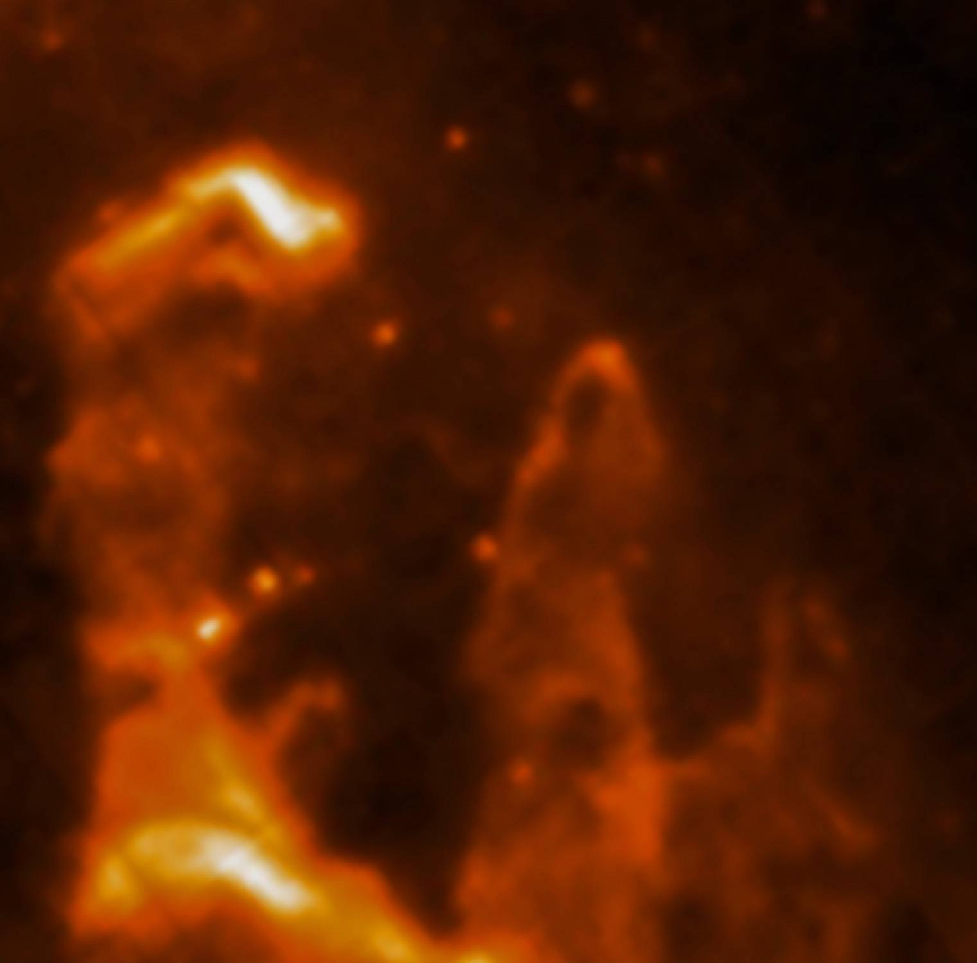
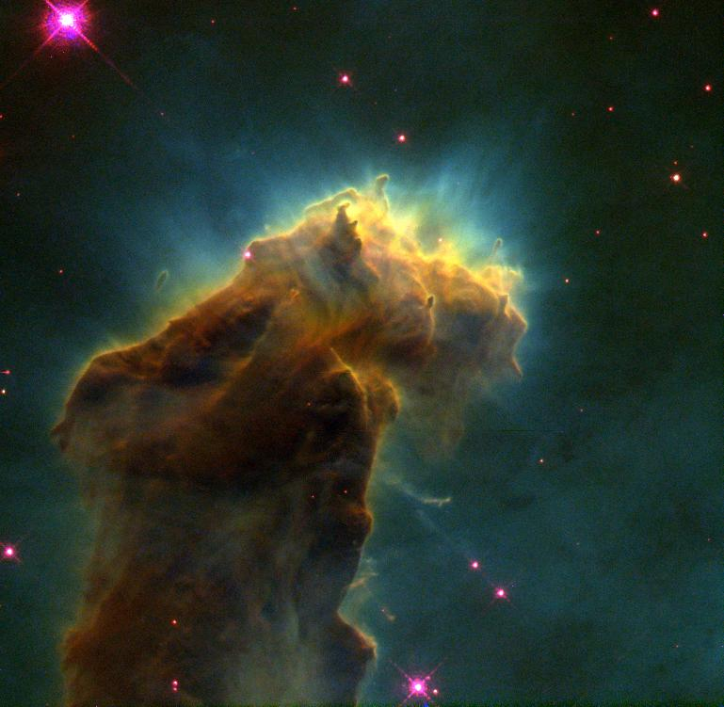
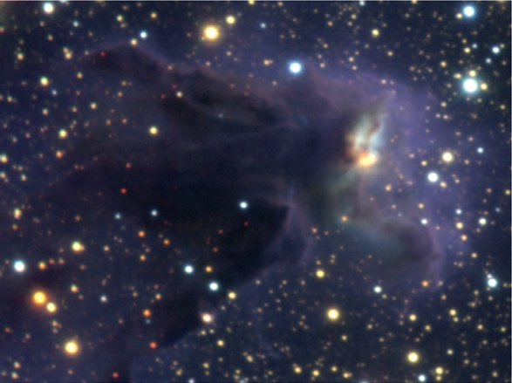
Star formation…
0.5 pc
Credit:
Optical: NASA, ESA, STScI, J. Hester and P. Scowen (Arizona State University)
NIR: ESO/M. McCaughrean & M. Anderson (AIP)
MIR: ESA/Herschel/PACS/SPIRE/Hill, Motte, HOBYS Key Programme Consortium
Notes:
Eagle Nebula (M16)
-There’s actually HIGH-mass SF going on (glowing, evaporating)
-We, however are going to journey inside to look at low-mass forming stars: Class 0s, in particular (rising SED between 2 & 8 microns)

Slide 5
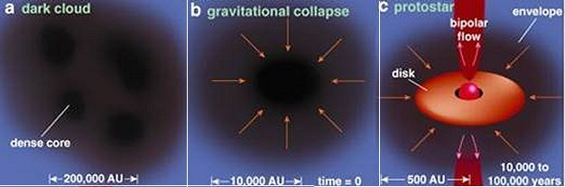
Non-magnetized star formation
Pulling in:
Gravity
Pushing out:
Turbulent pressure
Thermal pressure
Rotational support
Note:
Dark cloud
Dense core
Protostar
~1 pc
~0.1 pc
~0.01 pc
Credit: Spitzer Science Center
Notes:
-Mention Class 0

Slide 6
Non-magnetized star formation
Pulling in:
Gravity
Pushing out:
Turbulent pressure
Thermal pressure
Rotational support
Magnetic pressure
Will the cloud collapse?
“Subcritical”
(WILL NOT collapse)
“Supercritical”
(WILL collapse)
Notes:
Ionization: molecular clouds are ionized at a low level, and are threaded by weak magnetic fields (ISM polarization: B = 6 uG…about 1 mG in protoplanetary disk if you drag it all in)
Flux freezing: B-fields are frozen to matter, and get dragged in as cores collapse
E_{\rm{grav}} > E_{\rm{rot}}
E_{\rm{turb}} > E_{\rm{th}}
E_{\rm{turb}} \approx E_{\rm{mag}}
\frac{E_{\rm{grav}}}{E_{\rm{mag}}} < 1

Slide 7
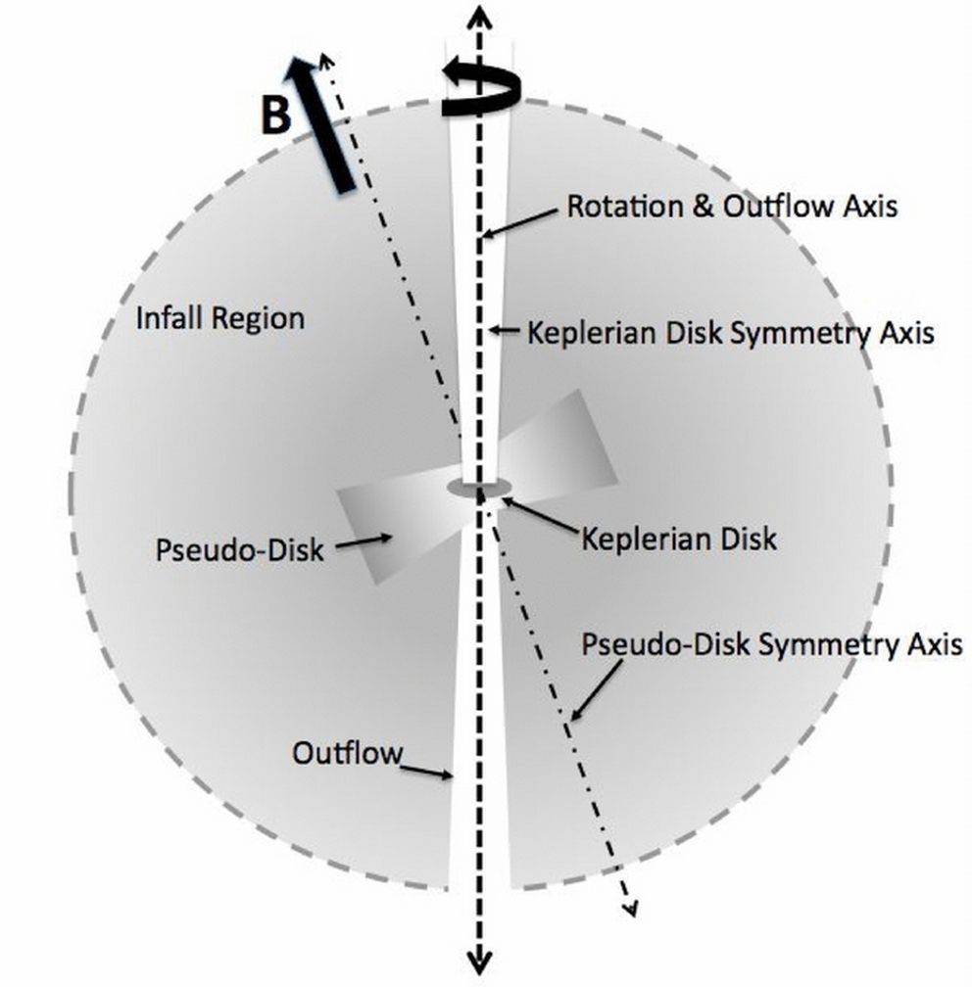
Star formation…with B-fields
Keplerian disk
100 AU
Dense core
10⁴ AU
(~0.1 pc)
“Pseudodisk”
1,000 AU
Davidson+ 2011
How do B-fields behave on different scales?
Notes:
-Collapsing envelope
-Magnetically supported, collapsing “pseudodisk”
-Keplerian (rotationally supported…?) disk in the middle, aligned with rotation & outflow
-Ang mom can be thrown out by torsional Alfven waves in the outflow…that’s sort of the same thing as spreading angular momentum outward by magnetic braking

Slide 8
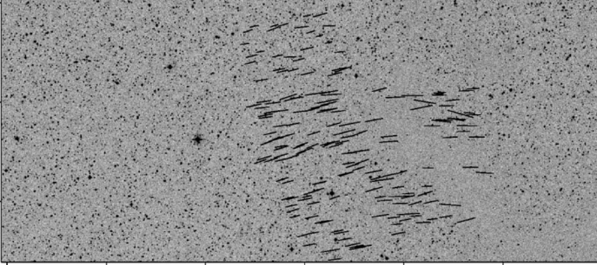
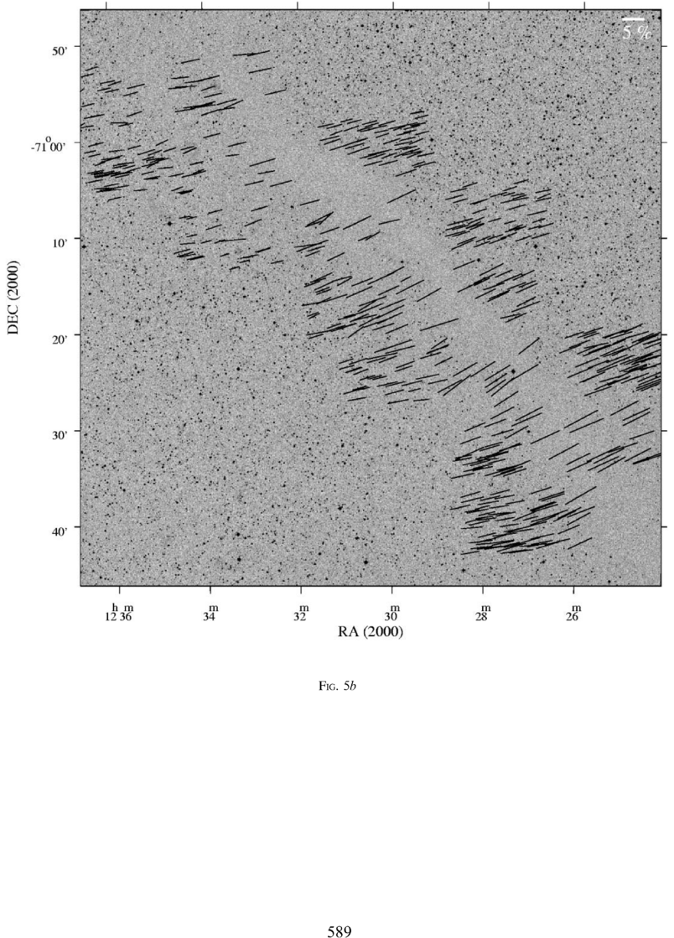
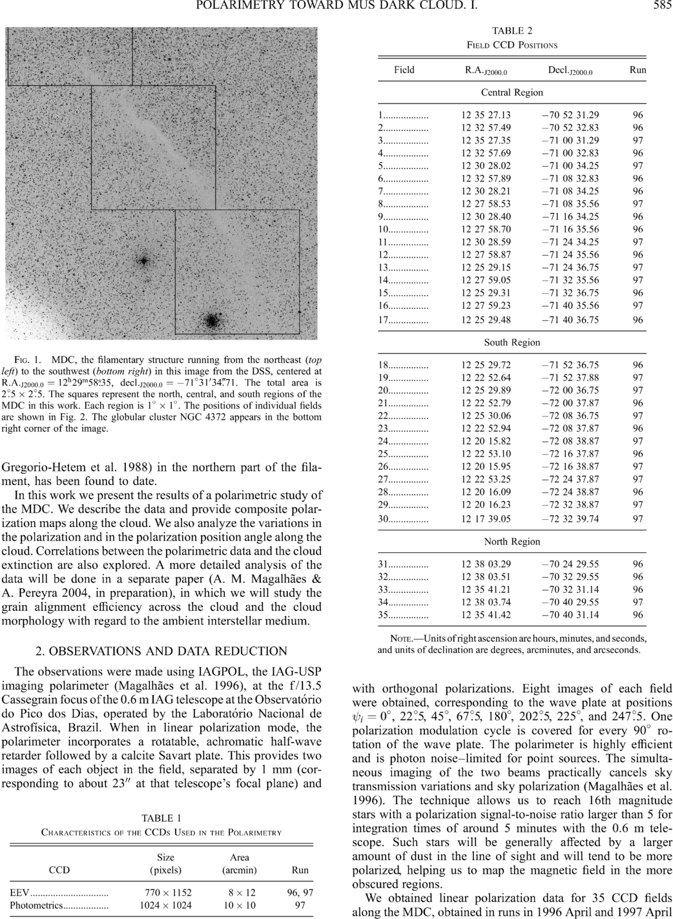
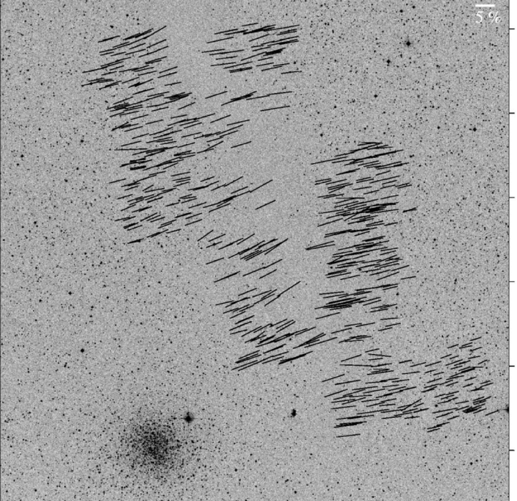
Large-scale: ordered fields
Musca dark cloud
E,B
~10 pc
Pereyra & Magalhães 2004
Notes:
-Distance: 250 pc
-Mass: 250 solar masses
-Length ~10 pc

Slide 9
Large → medium scale: consistent B-field in clouds & cores
E,B
~0.3 pc
E
B
Li+ 2009
Sub-mm CSO data
n ~ 10⁵ cm⁻³
L ~ 0.3 pc
Optical data
n ~ 1 cm⁻³
L ~ 100 pc
Notes:
Orion Molecular Cloud region
-Optical polarimetry data: blue vectors
-Huge grey vectors: average of all blue vectors
-IRAS data: just to guide the eye (background image)
-CSO data: dust emission
-White vectors: average of CSO dust polarization
-ALL orientations are B-field directions
-Comparing with simulations, they find that a super-Alfvénic cloud (more turbulence than magnetic support) doesn’t fit well

Slide 10
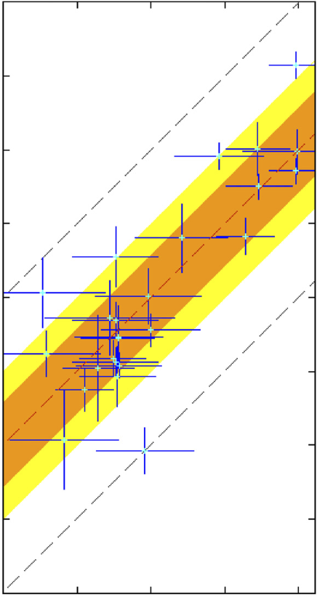
Large → medium scale: Consistent B-fields
B_{amb} (deg)
0
90
180
B_{core} (deg)
90
0
Li+ 2009
Li+ 2009
-90
Notes:
Orion Molecular Cloud region
-Optical polarimetry data: blue vectors
-Huge grey vectors: average of all blue vectors
-IRAS data: just to guide the eye (background image)
-CSO data: dust emission
-White vectors: average of CSO dust polarization
-ALL orientations are B-field directions
-Comparing with simulations, they find that a super-Alfvénic cloud (more turbulence than magnetic support) doesn’t fit well

Slide 11
Smaller-scale: still important?
Fields are consistent from ~100 pc → ~0.1 pc
What about at scales < ~0.1 pc (e.g. protostellar envelope)?
If B-fields are consistent down to smaller scales, they should be aligned with outflows

Slide 12
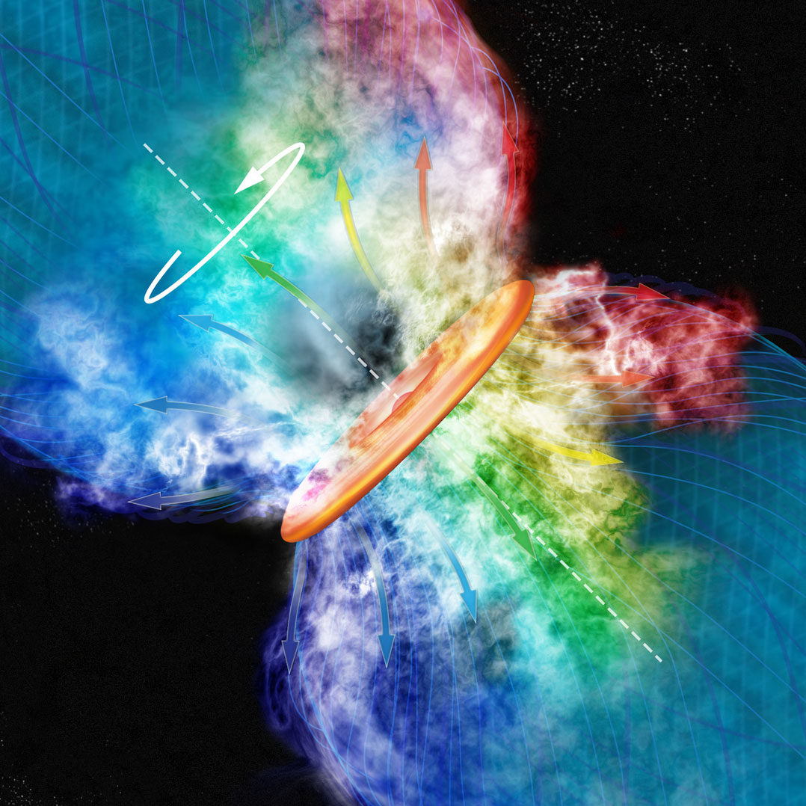
Simple model of SF with B-fields
Credit: Bill Saxton, Harvard-Smithsonian Center for Astrophysics
Notes:
-Note 0º between rotation/outflow axis, and poloidal component of B-field
-The is problematic when it comes to forming rotationally-supported disks (Hennebelle & Ciardi ’09)

Slide 13
Misalignment of B-fields and outflows
IRAS 4A
VLA 1623
IRAS 16293
Rao+ 2009
Holland+ 1996
Outflow
B-field
Girart+ 2006
Notes:
ROTATION: IRAS 16293 has rot/grav < 0.1; IRAS4A seems the same (barely any rotation); VLA 1623 questionable (probably slow)
-Holland: JCMT data
-Rao, Girart: SMA
-This is okay, according to Hennebelle & Ciardi ‘09 (easier to form disks with obliquity!)
-Ward-Thompson et al (2009) saw a 30 deg offset between short axes of cores and their polarization directions…another problem!

Slide 14
Outline
B-fields in star formation
Motivation & overview
Large scales (~10 pc) → small scales (~1000 AU)
TADPOL survey
CARMA polarization system
Survey outline
Results
Sample polarization maps
B-field vs. outflow (mis)alignment
Discussion

Slide 15
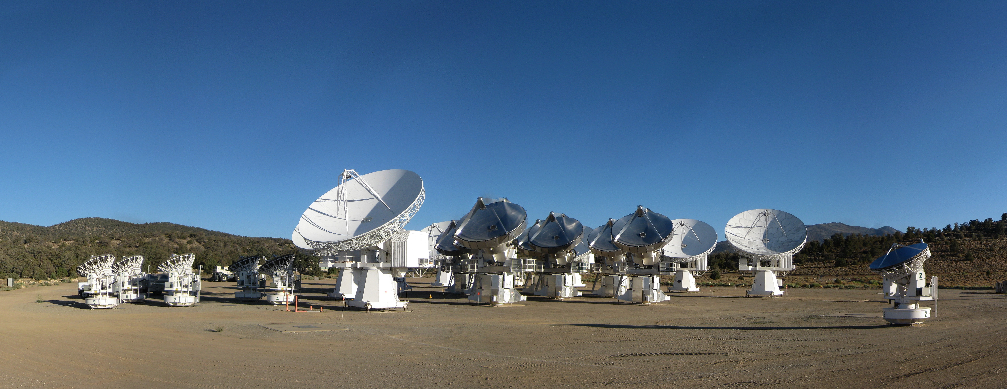
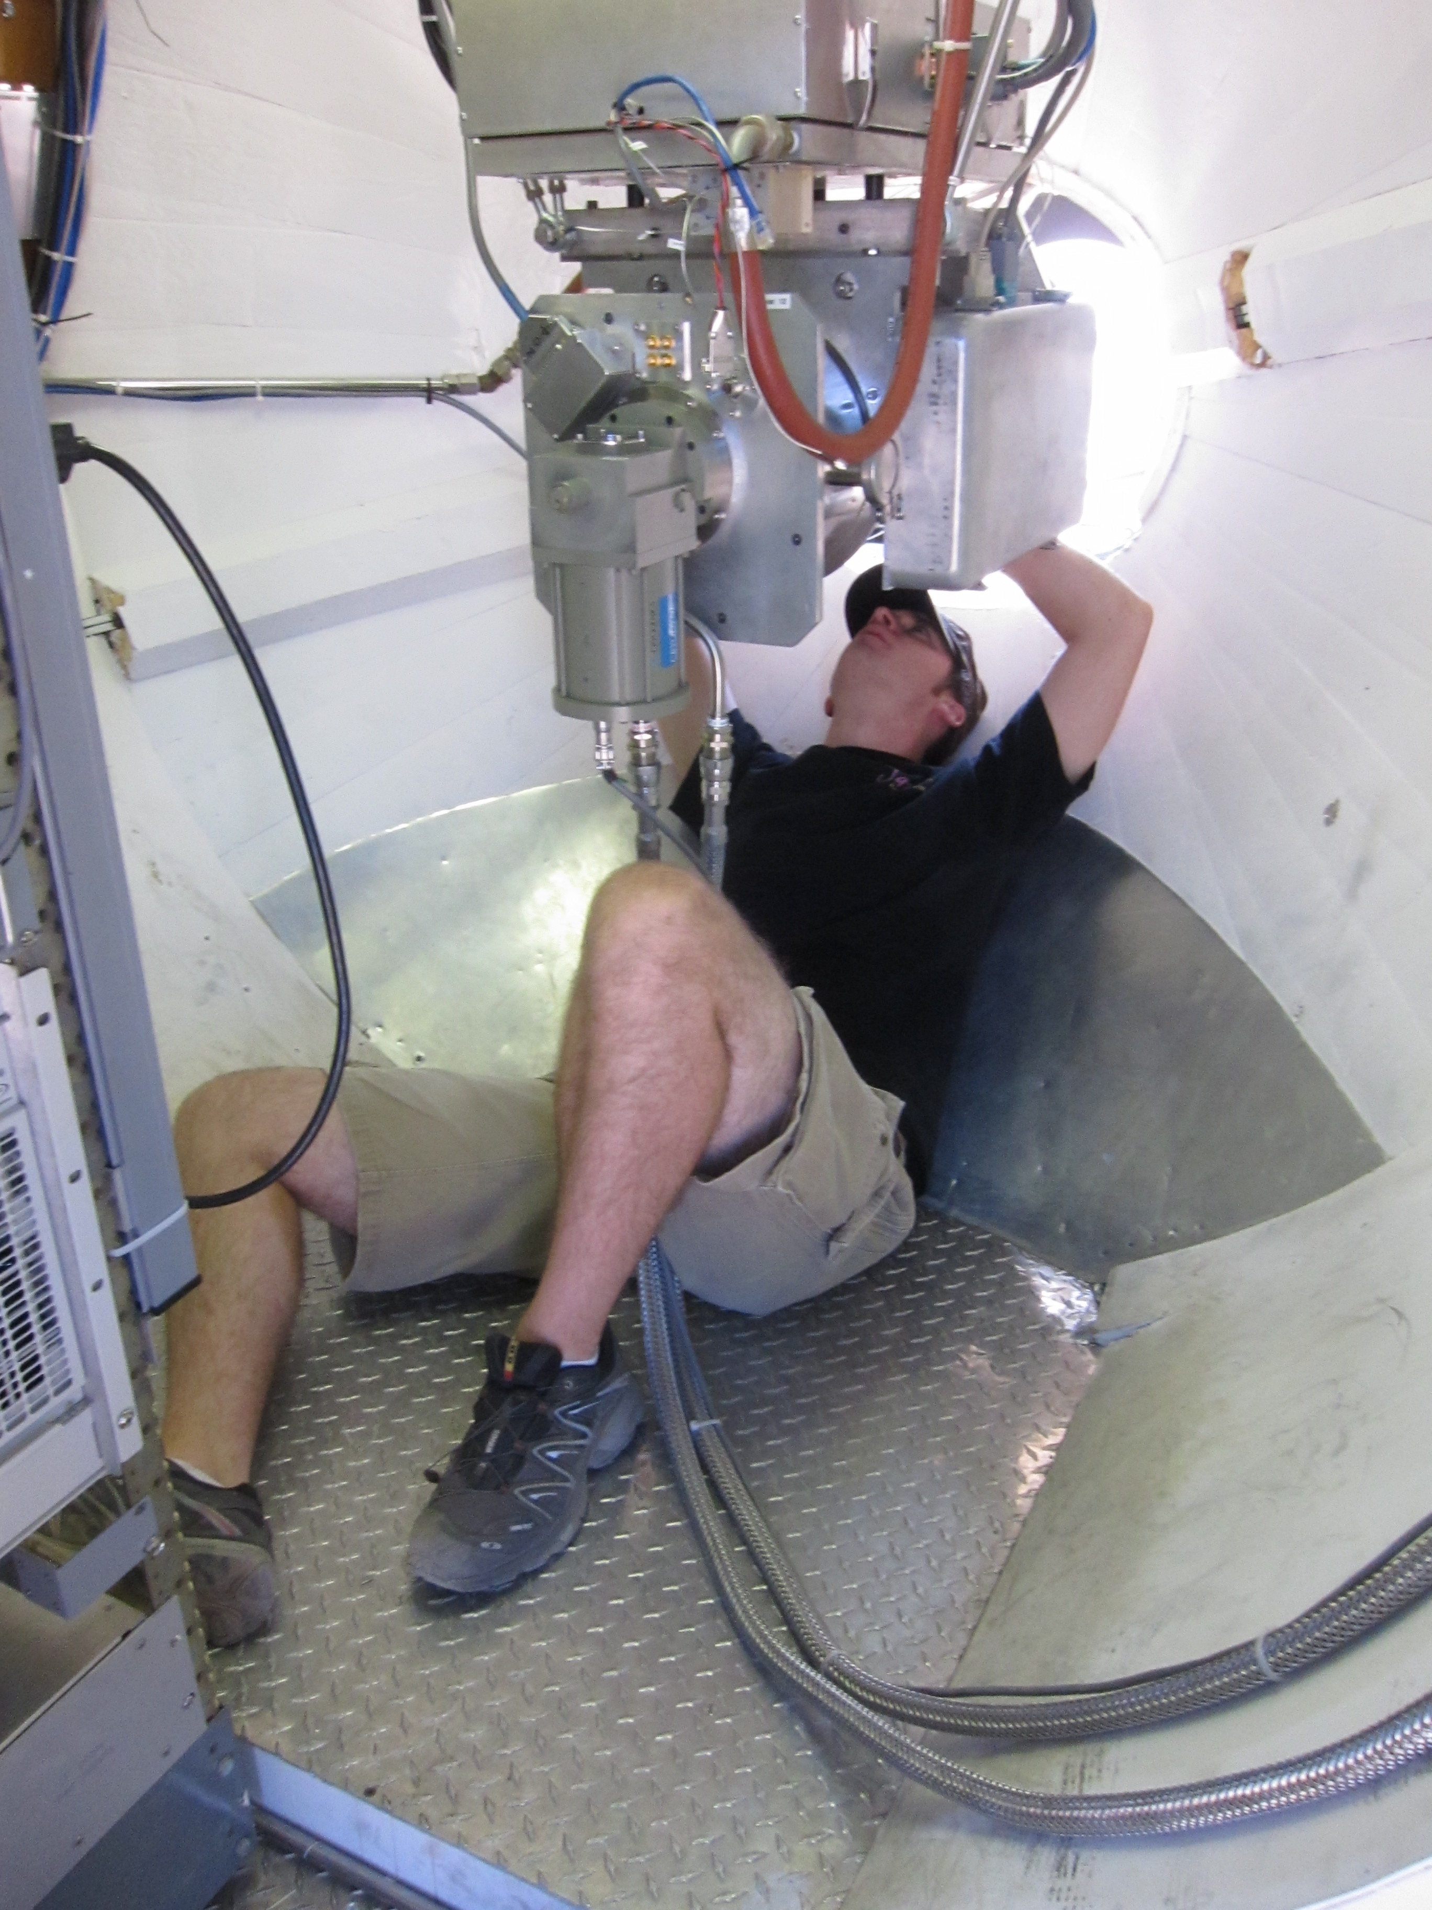
CARMA Combine Array for Research in Millimeter-wave Astronomy Consortium: Berkeley, Caltech, Illinois, Maryland, Chicago
6 ⨯10-m, 9 ⨯ 6-m, 8 ⨯ 3.5-m telescopes
Observations at 1 mm, 3 mm, and 1 cm
Located in Cedar Flat, CA (near Bishop)
Notes:
SMA: 8*6m antennas = 226 m^2
CARMA: 6*10m, 9*6m = 726 m^2 (more than factor of 3 more area)
-Factor of two more dishes
-Equivalent T_sys?

Slide 16
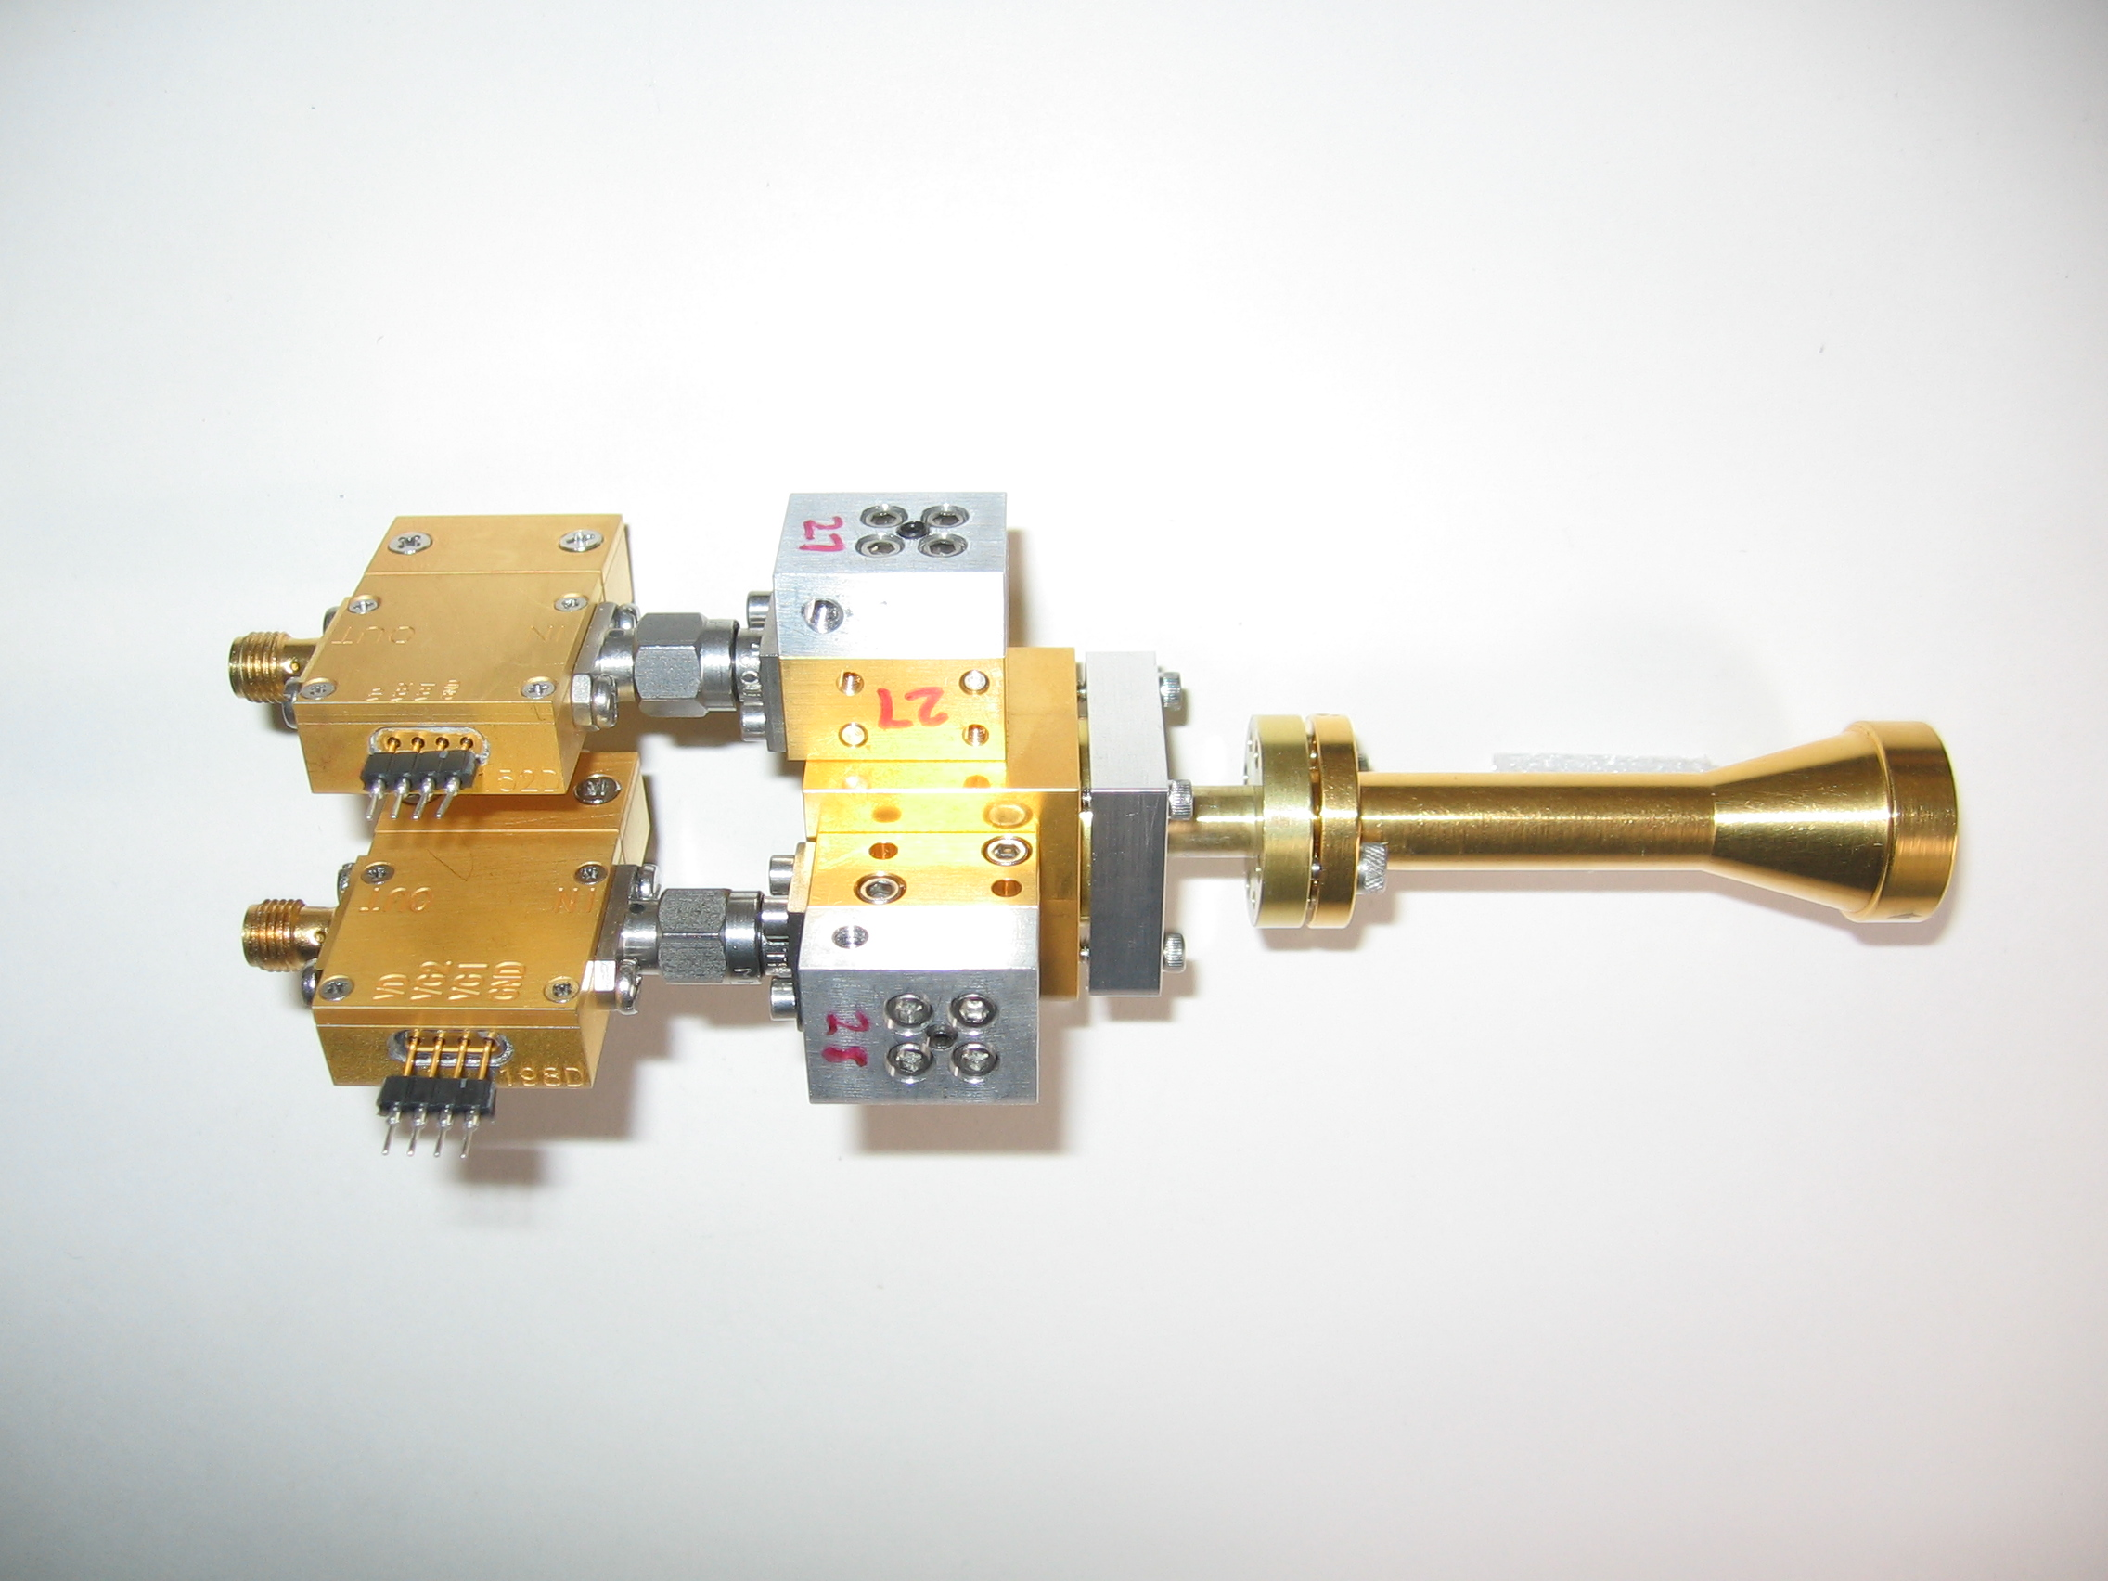
1 mm dual-polarization receivers
SIS mixers
Orthomode transducer
Waveguide circular polarizer
1 inch
WBA13
I.F. amplifiers (1-9 GHz)
Credit: Dick Plambeck
Notes:
-Sensitive to RCP & LCP
-Null experiment: in the absence of linear polarization, you get no RL correlation at any time.
-If you have linear feeds, you have XY correlation sometimes (when the intrinsic polarization is at 45º to your two feeds), and not other times (when it’s along one feed or the other). Thus, to tease out the polarization, you need stable gains

Slide 17
TADPOL survey
35 sources
Triples number of interferometric polarization maps
~300 observing hours
CARMA C, D, & E arrays
1 – 4" resolution
10⨉ higher resolution than CSO & JCMT
Probes intermediate region between ~0.1 pc (single-dish) and ~100 AU (ALMA)
1 mm wavelength
Ideal for dust polarization, as well as CO(2-1) for outflow mapping

Slide 18
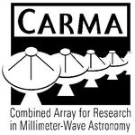











TADPOL collaboration
UC Berkeley
Chat Hull (PI), Dick Plambeck, Meredith Hughes, Mel Wright, Carl Heiles, Geoff Bower
University of Maryland
Marc Pound, Alberto Bolatto, Katherine Jameson, Lee Mundy
Caltech
Thushara Pillai, John Carpenter, James Lamb, Nikolaus Volgenau
University of Illinois, Urbana-Champagne
Ian Stephens, Leslie Looney, Woojin Kwon, Dick Crutcher, Nick Hakobian
Other
Jason Fiege (Manitoba), Erica Franzmann (Manitoba), Martin Houde (UWO, Caltech), Dan Marrone (Arizona), Brenda Matthews (NRC-CNRC), John Vaillancourt & Göran Sandell(USRA-SOFIA), John Tobin (NRAO)

Slide 19
Outline
B-fields in star formation
Motivation & overview
Large scales (~10 pc) → small scales (~1000 AU)
TADPOL survey
CARMA polarization system
Survey outline
Results
Sample polarization maps
B-field vs. outflow (mis)alignment
Discussion

Slide 20
TADPOL results
L1157
Notes:
NEARBY SF regions:
-Perseus (NGC 1333, L1448, SVS13): 235 pc (masers in SVS13) → 03:30 LST
-Taurus (DG Tau, L1527): 140 pc → 04:30 LST
-Orion: 400 pc → 05:30 LST
-Serpens: 415 pc → 18:30 LST
-Ophiuchus: 140 pc → 17:00 LST
-Cepheus (L1157): 250 pc → 22:00 LST
-Isolated (B335, Bok globule): 250 pc

Slide 21
TADPOL results
NGC 1333-IRAS 4A
NGC 1333-IRAS 2A
Notes:
NEARBY SF regions:
-Perseus (NGC 1333, L1448, SVS13): 235 pc (masers in SVS13) → 03:30 LST
-Taurus (DG Tau, L1527): 140 pc → 04:30 LST
-Orion: 400 pc → 05:30 LST
-Serpens: 415 pc → 18:30 LST
-Ophiuchus: 140 pc → 17:00 LST
-Cepheus (L1157): 250 pc → 22:00 LST
-Isolated (B335, Bok globule): 250 pc

Slide 22
TADPOL results
NGC 1333-IRAS 4B
Ser-emb 8
Notes:
NEARBY SF regions:
-Perseus (NGC 1333, L1448, SVS13): 235 pc (masers in SVS13) → 03:30 LST
-Taurus (DG Tau, L1527): 140 pc → 04:30 LST
-Orion: 400 pc → 05:30 LST
-Serpens: 415 pc → 18:30 LST
-Ophiuchus: 140 pc → 17:00 LST
-Cepheus (L1157): 250 pc → 22:00 LST
-Isolated (B335, Bok globule): 250 pc

Slide 23
Outflow vs. B-field: distribution
Simulation: outflows & B-fields aligned within a 20º cone (takes into account projection effects)
Simulation: outflows & B-fields are randomly oriented
Cumulative Distribution Function (CDF)
KS-test results:
20º cone ruled out (p-value ~ 10⁻⁹)
Random orientations cannot be ruled out (p-value ~ 0.5)
Hull+ 2012, in prep.
Angle between outflow & B-field (deg)

Slide 24
Discussion

Slide 25
Scales, scales, scales
10,000 AU
(~0.1 pc)
100 AU
1,000 AU
(~0.01 pc)
Davidson+ 2011
Notes:
-Collapsing envelope
-Magnetically supported, collapsing “pseudodisk”
-Keplerian (rotationally supported…?) disk in the middle, aligned with rotation & outflow
-Ang mom can be thrown out by torsional Alfven waves in the outflow…that’s sort of the same thing as spreading angular momentum outward by magnetic braking

Slide 26
Misalignment from largest to smallest scales
~100 AU
CDF
~1 pc
Targon+ 2011
Angle between optical jet & ambient B-field (deg)

Slide 27
Misalignment from smaller to smallest scales
CDF
~100 AU
~1000 AU
Angle between outflow & B-field (deg)
Notes:
-Hennebelle & Ciardi REQUIRE misalignment to create disks!
-Z-Y Li et al see magnetic catastrophe as a result of B-braking when B-field and rotation are aligned
MAIN CONCLUSIONS HERE:
somewhere between 10,000 AU and 1,000 AU, fields are getting dragged around and reoriented
those fields, at 1000 AU, are also randomly aligned with outflows:

Slide 28
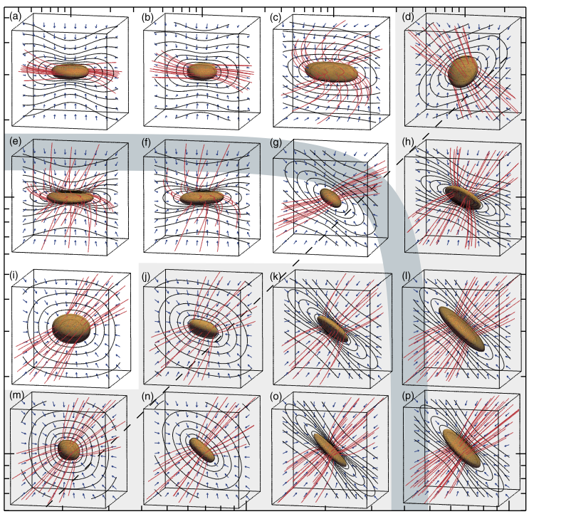
Achieving (mis)alignment: simulations
Machida+ 2006
Faster core rotation → →
Stronger B-field → →
Notes:
McKEE SAYS: initial misalignments could be from turbulence; his simulations drive turb at scales of ~0.5 pc
-He seems misalignment with angmom and ambient B-field
-INTERPLAY BETWEEN U_rot, U_grav, and U_B!
-y-axis: rot. rate / free-fall time
-x-axis: sqrt [ B-pressure / thermal pressure ]
-These started with 45º obliquity
-When magnetically dominated, core B-field and outflow line up
-When rotationally dominated, B-field can end up perp to outflow!
-Most cores tend to fall in the ~0.02 U_rot/U_grav area (Goodman et al. ‘93), but there are cores with a ratio of up to 1…

Slide 29
Achieving (mis)alignment: simulations
Kataoka+ 2012: http://arxiv.org/abs/1210.7637v1
Notes:
Problem: how do the core rotation axes and the ambient B-fields get torqued around so much to begin with?
-This is an initial condition of these simulations, but it’s not clear how it can happen
-McKee says he can get misalignment from turbulence

Slide 30
Achieving (mis)alignment: simulations
Additional notes on rotation/B-field misalignment:
Turbulence may cause initial misalignment at scales of ~0.1 pc (McKee)
Misalignment may be necessary for disk formation
(Joos+ ‘12, Li+ ’11, Hennebelle & Ciardi ’09)
?
Notes:
McKEE SAYS: initial misalignments could be from turbulence; his simulations drive turb at scales of ~0.5 pc
-He seems misalignment with angmom and ambient B-field
-INTERPLAY BETWEEN U_rot, U_grav, and U_B!
-y-axis: rot. rate / free-fall time
-x-axis: sqrt [ B-pressure / thermal pressure ]
-These started with 45º obliquity
-When magnetically dominated, core B-field and outflow line up
-When rotationally dominated, B-field can end up perp to outflow!
-Most cores tend to fall in the ~0.02 U_rot/U_grav area (Goodman et al. ‘93), but there are cores with a ratio of up to 1…

Slide 31
Conclusions
CARMA polarization
TADPOL survey nearly complete
Full-Stokes system at CARMA is open for proposals (deadline: 12/5!)
Results
Literature: B-fields are consistent from ~100 pc → ~0.1 pc
TADPOL: B-fields are randomly aligned with outflows (and thus with core rotation axes) at the ~1000 AU scale
Future
What happens to B-field direction from ~0.1 pc → ~1000 AU? [Compare with SCUBA]
What does B-field look like at ~100 AU? [Look with ALMA]
How do rotation and B-field axes compare at larger scales?
What is the intrinsic B-field structure inside the cores? [Modeling]
Notes:
Other TADPOL future possibilities:
Intrinsic modeling of B-fields in cores (Fiege)
Constraints on B-fields in protoplanetary disks (Hughes)
Turbulence power spectra (Houde)
Larger scale background-star maps (Mimir, Jameson/Pillai/Clemens)

Slide 32
Fin

